Slide 1
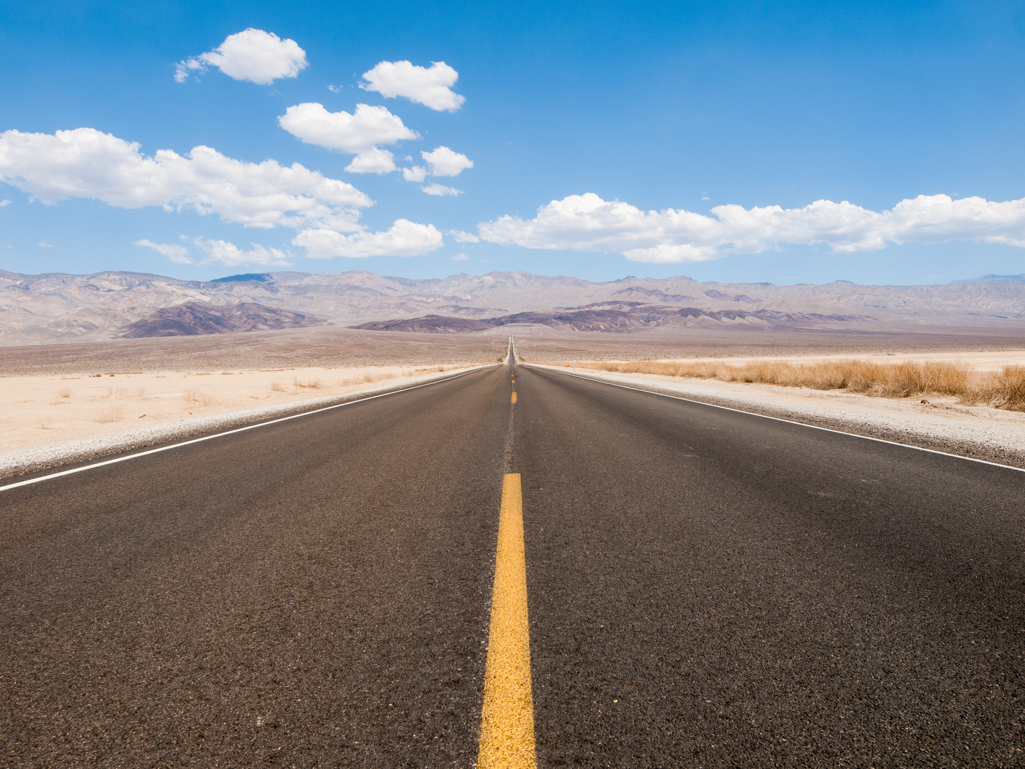
WHAT ARE YOU WAITING FOR? ROMANS 1:16-17

Slide 2
16 For I am not ashamed of the gospel, because it is God’s power for salvation to everyone who believes, first to the Jew, and also to the Greek.
17 For in it God’s righteousness is revealed from faith to faith, just as it is written: The righteous will live by faith.

Slide 3
Philippians 4:13 I am able to do all things through Him who strengthens me.

Slide 4
THE TWO MEANINGS OF FEAR
Forget Everything And Run
Face Everything And Rise

Slide 5
2 Timothy 1:7 For God has not given us a spirit of fearfulness, but one of power, love, and sound judgment.

Slide 6
Ephesians 2:8-10 For you are saved by grace through faith, and this is not from yourselves; it is God’s gift— not from works, so that no one can boast. For we are His creation, created in Christ Jesus for good works, which God prepared ahead of time so that we should walk in them.

Slide 7
Dietrich Bonhoeffer - “When Christ calls a man, he bids him come and die.”

Slide 8
1 Corinthians 1:18 For the message of the cross is foolishness to those who are perishing, but it is God’s power to us who are being saved.

Slide 9
Romans 3:23 For all have sinned and fall short of the glory of God.
Romans 6:23 For the wages of sin is death, but the gift of God is eternal life in Christ Jesus our Lord.

Slide 10
James 2:19 “You believe that God is one; you do well. The demons also believe—and they shudder.”

Slide 11
Mark 8:38 For what does it benefit a man to gain the whole world yet lose his life?
Acts 2:38 – 39 “Repent,” Peter said to them, “and be baptized, each of you, in the name of Jesus Christ for the forgiveness of your sins, and you will receive the gift of the Holy Spirit. For the promise is for you and for your children, and for all who are far off, as many as the Lord our God will call.”
Romans 10:9 If you confess with your mouth, “Jesus is Lord,” and believe in your heart that God raised Him from the dead, you will be saved.

Slide 12
Lester Roloff - A test of a Christian’s character is what he does after he comes to the blockade in the road and what his attitude is after everything has left him except Jesus.

Slide 13
James 1:2 – 4 Consider it a great joy, my brothers, whenever you experience various trials, knowing that the testing of your faith produces endurance. But endurance must do its complete work, so that you may be mature and complete, lacking nothing.

Slide 14
Galatians 5:13 “For you were called to be free, brothers; only don’t use this freedom as an opportunity for the flesh, but serve one another through love.”
Galatians 6:9 So we must not get tired of doing good, for we will reap at the proper time if we don’t give up.

